Slide 1

ADITYA ENGINEERING COLLEGE(A)
Fake News Detection
Project Guide:
Mr.S.V.V.D.Jagadeesh
Assistant prof.
Department of IT
Aditya Engineering College
Surampalem.
Project Associates:
Ch.Sri Bala Vidyadhari -17A91A1210
P.Hari Priya -17A91A1243
M.Hari Krishna -17A91A1231
B.Sireesha -17A91A1205

Slide 2

Aditya Engineering College(A)
Introduction To Project
FAKE NEWS DETECTION.
The main objective is to detect the fake news, which is a classic text classification problem with a straight forward proposition. It is needed to build a model that can differentiate between “Real” news and “Fake” news.
These days’ fake news is creating different issues from sarcastic articles to a fabricated news and plan government propaganda in some outlets.
Fake news and lack of trust in the media are growing problems with huge ramifications in our society.
In this PROJECT,it is seeked to produce a model that can accurately predict the likelihood that a given article is fake news or real news.
Fake News Prediction July 10th, 2021.

Slide 3
Aditya Engineering College(A)
Existing System
Fake News Detector was a feature added by Flock-a new generation messaging and collaborative platform.
Wheneverlinks are being sent to each while chatting, FND algorithm gets activated.It checks the content of links to their databases of websites computed according to rankings.
It gives a statistic rating and generates a warning message if the source is not found to be reliable.
Flocks database has more than 600 news URL’S that are fact-checked.
Drawbacks:
The drawback of this system is that their database for fact checking is less in number and chances of hoaxes still not being determined are high.
Fake News Prediction July 10th, 2021.

Slide 4
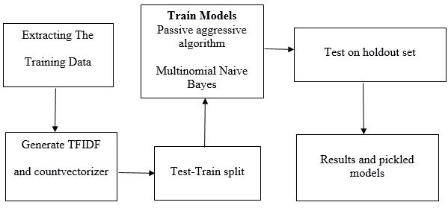
Proposed System
Aditya Engineering College(A)
Since this problem is a kind of text classification, Implementing a Naive Bayes classifier will be best as this is standard for text-based processing.
The actual goal is in developing a model which was the text transformation and choosing which type of text to use (headlines vs full text) .
Next step is to extract the most optimal features .
This is done by using a n-number of the most used words, and/or phrases, lower casing or not, mainly removing the stop words which are common words such as “the”, “when”, and “there” and only using those words that appear at least a given number of times in a given text dataset.
ADVANTAGES:
The Naive Bayes Classifier helps to predict the output with more accuracy than that of the existing systems.
Fake News Prediction July 10th, 2021.

Slide 5
Implementation of Algorithms
Aditya Engineering College(A)
LIAR Dataset
Python
Fake news
Sklearn
Numpy and Pandas
Fake News Prediction July 10th, 2021.

Slide 6
Aditya Engineering College(A)
SOFTWARE REQUIREMENTS
Fake News Prediction July 10th, 2021.

Slide 7
Aditya Engineering College(A)
Purpose
The purpose of the document is to provide support information on the Fake News prediction , collect and analyze all assorted ideas that have come up to define the system, its requirements with respect to consumers. It will also describe about the functional and non-functional requirements. In short, the purpose of this SRS document is to provide a detailed overview of our software product, its parameters and goals. This document describes the project's target audience and its user interface and software requirements. It defines how our client, team and audience see the product and its functionality This document is intended to be used by the members of the project team that will be implemented and to verify the correct functioning of the system.
Product Scope
Primarily, the scope of our project Fake News prediction is to predict the data through data analytics which is nothing but finding out whether the news is true or false. Based on the URL’s and the data we are going to predict the news. In this process some relevant and known data like User- based data, Knowledg-based,Style-based and Stance-based. Coming to the business strategies it is helpful by means of detecting the news whether it is real or fake . So that they can estimate their accuracy on believing the information.
Fake News Prediction July 10th, 2021.

Slide 8
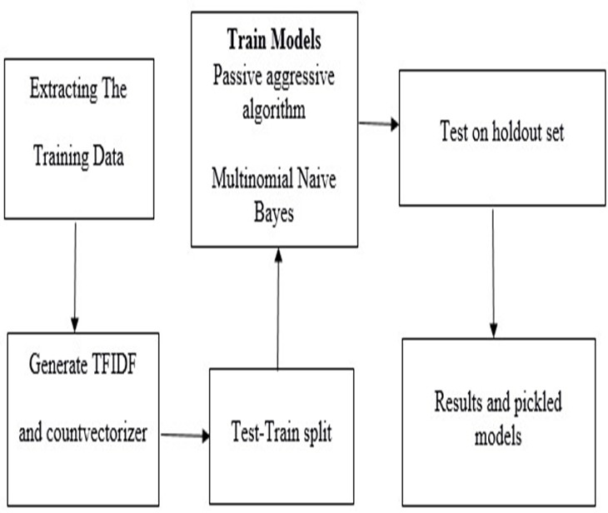
Aditya Engineering College(A)
References
Refsearch paper: https://bit.ly/3viOIuc.
These are the references where you can find out the terminologies used in the srs in detail
Data Flow Diagram Of Entire System
Fake News Prediction July 10th, 2021.

Slide 9
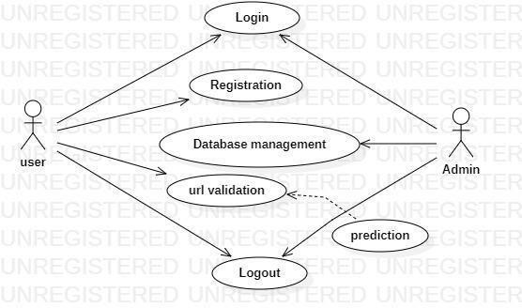
Product Function
Aditya Engineering College(A)
To predict the news based on the URL’s.
To make the correct information is reached to the people.
To notify the users whether the news or the information is fake or real.
Use Case Diagram of Overall System
Fake News Prediction July 10th, 2021.

Slide 10
User Classes and Characteristics
Aditya Engineering College(A)
UC-1: Data set
UC-2: users
UC-3: System/Software
Ch-1: The data set we use here is a “LIAR” data set. This data set consists of all types of data such as news, knowledge based etc.…
Ch-2: A user is a person(he/she) who wants to predict the news.
Ch-3: System/software are the software applications we need to do the project such as, jupyter or spyder( both jupyter and spyder are interactive environments ).We can also use command prompt for finding the accuracy of the data.
Assumptions and Dependencies
Scikit-Learn
Scikit-learn (formerly scikits.learn and also known as sklearn) is a free software machine learning library for the Python programming language. It features various classification, regression and clustering algorithms including support vector machines, random forests, gradient boosting, k-means and DBSCAN, and is designed to interoperate with the Python numerical and scientific libraries NumPy and SciPy.

Slide 11
Aditya Engineering College(A)
NumPy:
NumPy is a library for the Python programming language, adding support for large, multi-dimensional arrays and matrices, along with a large collection of high level mathematical functions to operate on these arrays.
Pandas:
pandas is a fast, powerful, flexible and easy to use open source data analysis and manipulation tool , built on top of the Python programming language.
Flask:
Flask is a lightweight WSGI web application framework. It is designed to make getting started quick and easy, with the ability to scale up to complex applications. It began as a simple wrapper around Werkzeug and Jinja and has become one of the most popular Python web application frameworks.
Flask offers suggestions, but doesn't enforce any dependencies or project layout. It is up to the developer to choose the tools and libraries they want to use. There are many extensions provided by the community that make adding new functionality easy.
Fake News Prediction July 10th, 2021.

Slide 12
External Interface Requirements
Aditya Engineering College(A)
User Interfaces
Jupyter notebook for user interface.
We can also use spyder for more interactivity.
Browser.
Hardware Interfaces
The hardware interfaces that are used for login and prediction are:
Hard disk :30GB, RAM: 1GB, Multimedia: Keyboard
Software Interfaces
In this software interfaces the operating system that we are going to implement our code is Window
System Features
Description and Priority
Decreases the spreading of false information
Stimulus/Response Sequences
Registration, login and Prediction.
Fake News Prediction July 10th, 2021.

Slide 13
Functional Requirements
Aditya Engineering College(A)
REQ 1: Dataset.
REQ 2: UI.
REQ 3: Work-flow Performance.
REQ 4: The system should be able to summarize the entire information and provide the exact output.
ALGORITHMS:
A1: Multinomial Naive Bayes
Non Functional Requirements
Performance Requirements
Safety Requirements
Security Requirements
Software Quality Attributes
Fake News Prediction July 10th, 2021.

Slide 14
Design
For
Fake News Prediction
Fake News Prediction July 10th, 2021.

Slide 15
System Design
System design is transition from a user oriented, document oriented to programmers.
The design is a solution, a “how to” approach to the creation of a new system.
UML DIAGRAMS
Unified Modeling Language is the language used to visualize, specify, construct and document any component of software engineering.
The Unified Modeling Language allows the software engineer to express an analysis model using the modeling notation that is governed by a set of syntactic semantic and pragmatic rules.
Fake News Prediction July 10th, 2021.

Slide 16
DATA DICTIONARY
Field Name | Data Type | Description | Constraints
Username | Varchar(50) | Username of the User | Primary Key
Password | Varchar(50) | Password of the User | Primary Key
Email | Varchar(50) | Email of the User | Not Null
A data dictionary contains metadata i.e data about the database.
The data dictionary is very important as it contains information about database.
Database Table for User Registration
Fake News Prediction July 10th, 2021.

Slide 17
Use Case Diagram:
Use case diagram of Fake News Prediction.
Fake News Prediction July 10th, 2021.

Slide 18
User Classes and Characteristics
Uc-1: User
Uc-2: Admin
Ch-1: Login/logout
Ch-2: Signup
Ch-3: Database Management
Ch-4: URL validation
Ch-5: Prediction
Use case diagrams are created to visualize the relationships between actors and use cases. A use case is a pattern of behavior the system exhibits. Actor in a use case diagram is any entity that performs a role in one given system. An use case represents a function or an action within the system.
Fake News Prediction July 10th, 2021.

Slide 19
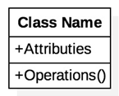
Class Diagram
A Class diagrams describe the static structure of a system, or how it is structured rather than how it behaves.
Class diagram gives an overview of a system by showing its classes and the relationships among them.
UML class is a rectangle divided into: class name, attributes, and operations.
Our class diagram has three kinds of relationships.
Association
Aggregation
Generalization
Fake News Prediction July 10th, 2021.

Slide 20
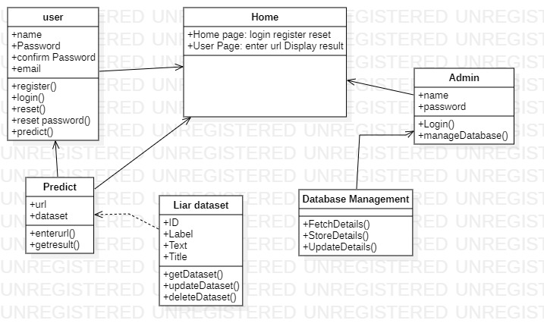
Class Diagram
Class Diagram of fake news prediction.
The above class diagram specifies the procedure followed by user for registration, login, authentication. The user should follow all the attributes to perform the corresponding operations. The user can perform operations such as login into his/her account and can predict the news. The User enters the details for login he/she can enter to homepage if he/she enter valid credientals.If not the will be redirected to login page.After entering the homepage the user can enter the url in searchbox and can predict the news.
Fake News Prediction July 10th, 2021.

Slide 21
Sequence Diagram
A type of interaction diagram, a sequence diagram shows the actors of the object participating in an interaction and the events they generate arranged in a time sequence.
Often a sequence diagram shows the events that results from a particular instance of a particular instance of a use case but a sequence diagram can also exist in a more generic form.
The vertical dimension in a sequence diagram represents time, with time proceeding down the page the horizontal dimension represents different actors.
Fake News Prediction July 10th, 2021.

Slide 22
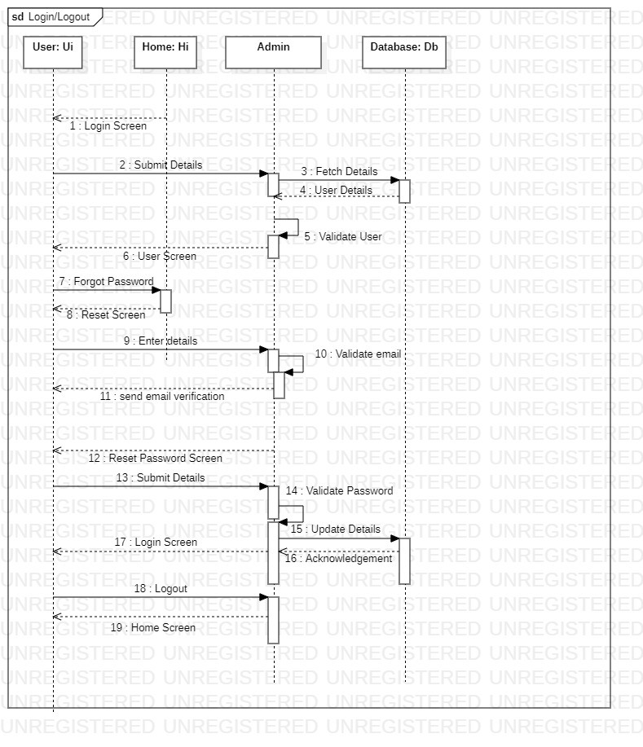
Sequence Diagram
Sequence Diagram for User login and logout.
The above sequence diagram specifies the sequential procedure followed by the User. Here the user will login and logout in the following manner.
Fake News Prediction July 10th, 2021.

Slide 23
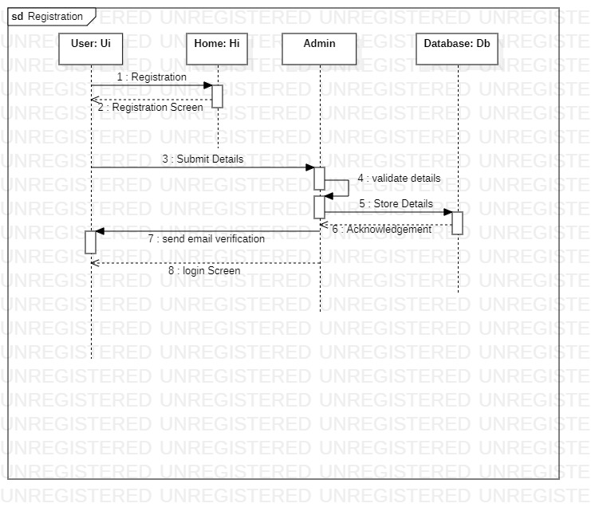
Sequence Diagram for User Registration.
The above sequence diagram specifies the sequential procedure followed by user to create an account. Here user details are stored in the database.
Fake News Prediction July 10th, 2021.

Slide 24
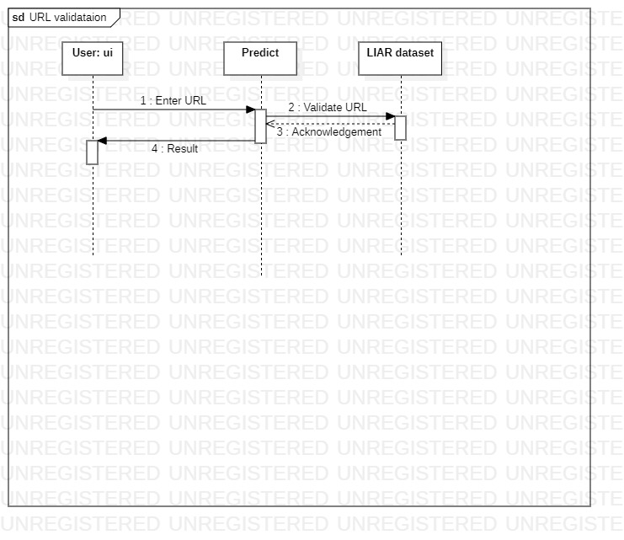
Sequence Diagram for Predicting result.
The above sequence diagram specifies the sequential procedure followed by the user to predict the result.
Fake News Prediction July 10th, 2021.

Slide 25
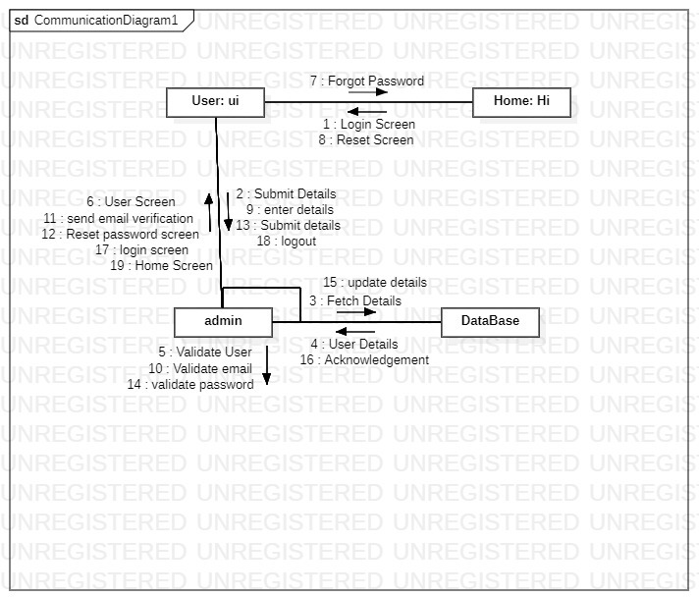
Collaboration Diagram
Collaboration Diagram for user login.
The above collaboration diagram specifies the sequential procedure followed by user to login.
Fake News Prediction July 10th, 2021.

Slide 26
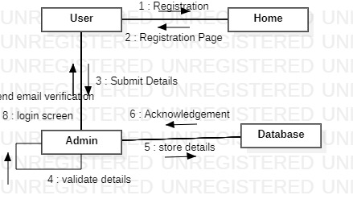
Collaboration Diagram for user registration.
The above collaboration diagram specifies the sequential procedure followed by the user to create an account.
Fake News Prediction July 10th, 2021.

Slide 27
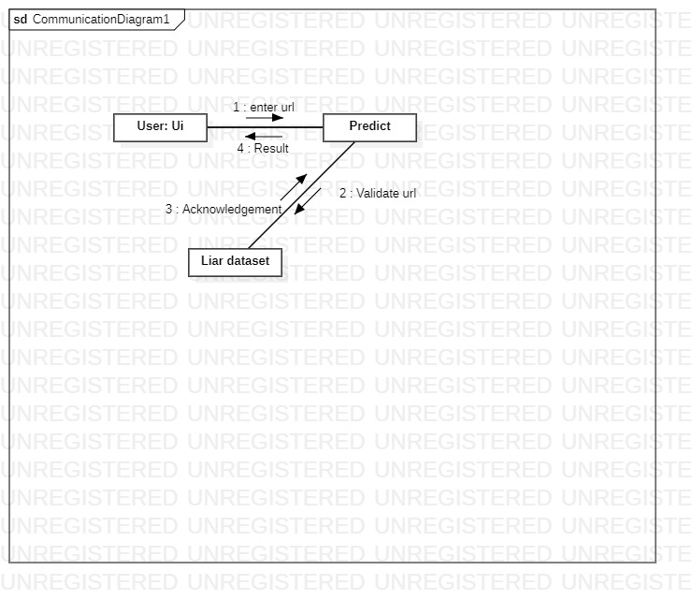
Collaboration Diagram for URL validation.
The above collaboration diagram specifies the sequential procedure followed by user to predict the news.
Fake News Prediction July 10th, 2021.

Slide 28
Activity Diagram
Activity diagram is basically a flow chart to represent the flow from one activity to another activity.
The activity can be described as an operation of the system. So, the control flow is drawn from one operation to another operation.
Activity diagrams are not only used for visualizing dynamic nature of a system, but they are also used to construct the executable system by using forward and reverse engineering techniques.
Activity diagram is some time considered as the flow chart. Although the diagrams look like a flow chart but it is not. It shows different flow like parallel, branched, concurrent and single.
Fake News Prediction July 10th, 2021.

Slide 29
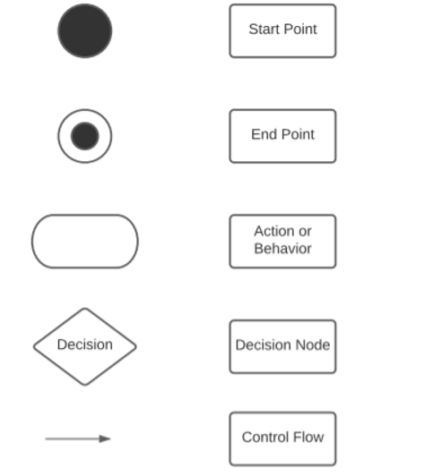
Activity Diagram
Fake News Prediction July 10th, 2021.

Slide 30
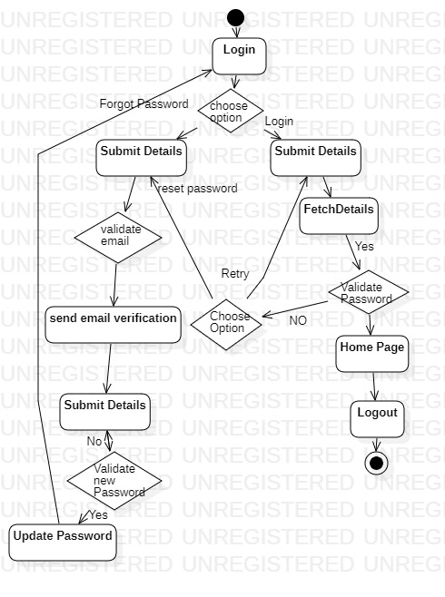
Activity Diagram
Activity Diagram for Login and logout.
The above activity diagram shows the flow of activities of login system. It shows about the start and stop states of the flow along with the decisions and counter statements.
Fake News Prediction July 10th, 2021.

Slide 31
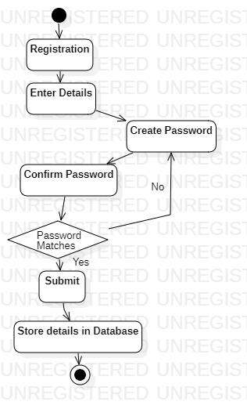
Activity Diagram for user Registration.
The above activity diagram shows the flow of activities followed by user for creating new account or registration. It shows about the start and stop states of the flow along with the decisions and counter statements.
Fake News Prediction July 10th, 2021.

Slide 32
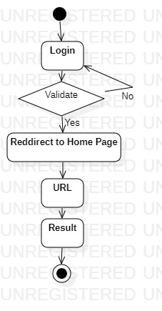
Activity Diagram for Predicting news.
The above activity diagram shows the flow of activities of predicting the news(fake or real). It shows about the start and stop states of the flow along with the decisions and counter statements.
Fake News Prediction July 10th, 2021.

Slide 33
Test Cases
Testcase id | Input | Description | Expected Results | Pass/Fail
TC_01 | Email blank and Password blank | A blank username and blank password given by the user. | Enter email and password | Fail
TC_02 | Email blank and Password filled | A blank Email and password filled by the user. | Enter the email id | Fail
TC_03 | Email filled And password blank | Email filled and blank password Given by the user. | Please enter the password | Fail
TC_04 | Correct Email and incorrect Password | When user enters only incorrect Password | Enter the correct password | Fail
TC_05 | incorrect Email and correct password | When user enters incorrect email id | Enter the registered email | Fail
TC_06 | Correct Email and Password | When user enters Registered email and correct password | Valid | Pass
Testcases for User Login Form
Fake News Prediction July 10th, 2021.

Slide 34
Testcase Id | Input | Description | Expected Results | Pass/Fail
TC_01 | Name blank and All fields filled | Name is not entered by the user | Fill all the details | Fail
TC_02 | Password and confirm password not Matched | When the password and confirm password are not same | Passwords do not match | Fail
TC_03 | Password less than 6 digits | When the user enters the password less than 6 letters | Password must be at least 6 characters | Fail
TC_04 | Password with digits | When user enters only digits as password | Valid | Pass
TC_05 | Password with both digits and letters | When user enters both digits and letters as password. | Valid | Pass
TC_07 | Email ID Without domain name | When user enters email ID without domain name like@domain.co m | Please enter valid email id | Fail
TC_08 | Email id with domain name | When user enters email id with domain name | Valid | Pass
TC_09 | Name filled, valid email id, same password and confirm password | User enters all the correct details | Valid | Pass
Testcases for User Registration Form
Fake News Prediction July 10th, 2021.

Slide 35
Testcase id | Input | Description | Expected Results | Pass/Fail
TC_01 | No URL is given | When user does not enter any URL | Invalid URL | Fail
TC_02 | URL is given | When the user enters the valid URL | Valid | Pass
Test cases for entering the URL
Fake News Prediction July 10th, 2021.

Slide 36
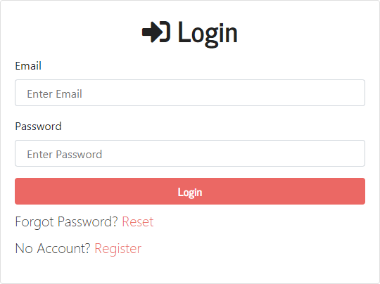
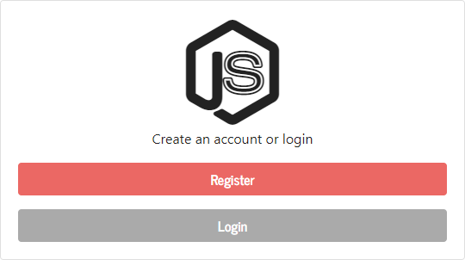
SCREENSHOTS
Screenshot For Home Page
Screenshot for Login Page
Fake News Prediction July 10th, 2021.

Slide 37
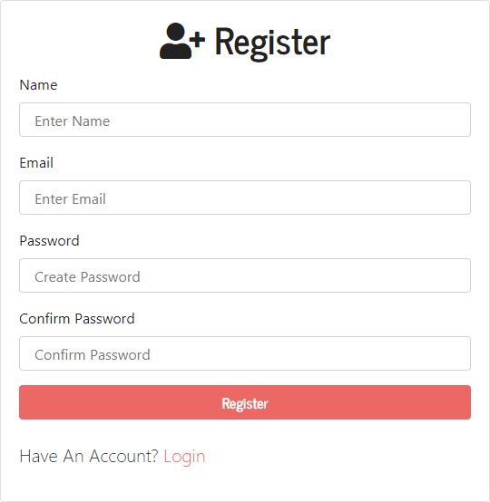
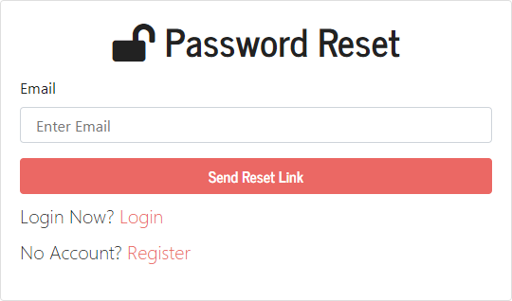
Screenshot for Password reset Page
Screenshot for registration Page
Fake News Prediction July 10th, 2021.

Slide 38
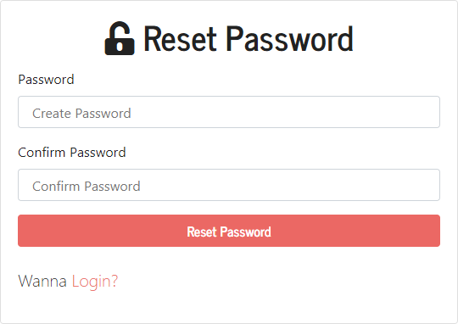
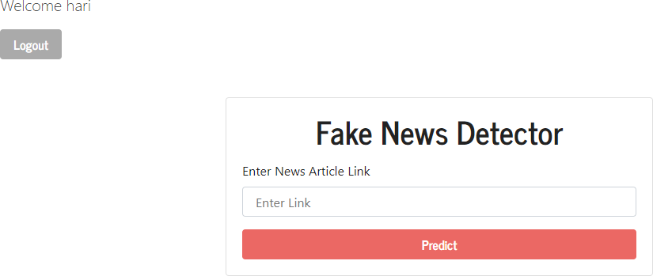
Screenshot for Resetting Password
Screenshot of Dashboard Page
Fake News Prediction July 10th, 2021.

Slide 39
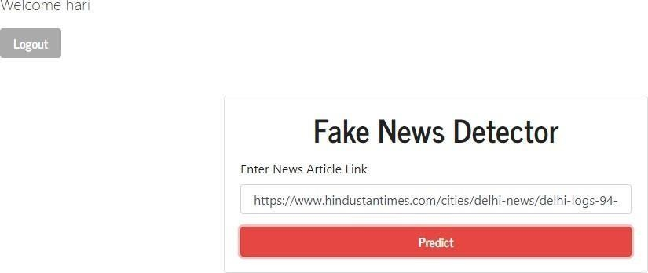
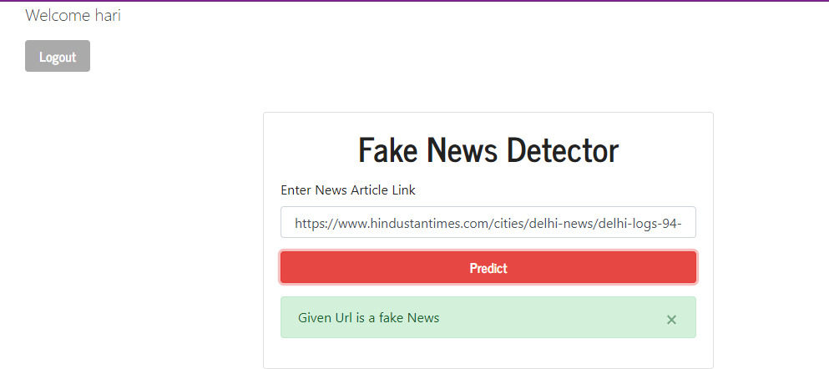
Screenshot for the predicted result
Screenshot for entering the URL
Fake News Prediction July 10th, 2021.

Slide 40
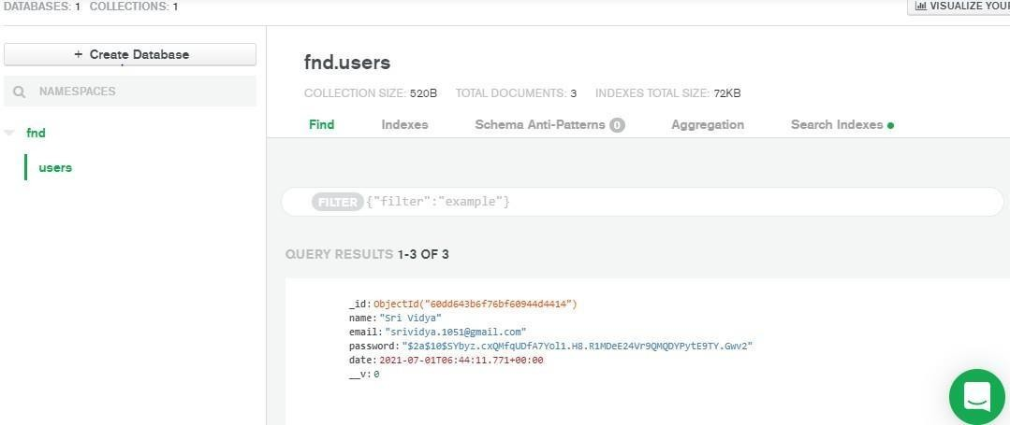
Screenshot for the collections in database
Fake News Prediction July 10th, 2021.

Slide 41
CONCLUSION
As evident above for static search, our best model came out to be Naïve Bayes Classifier with an accuracy of above 80%. Hence, we can say that if a user feed a particular news article or its headline in our model, it will be classified to its true nature.
FUTURE SCOPE
The purpose of this project was to build a model that help us to recognize the language patterns that can be used to classify fake and real news with the help of ML (machine learning) techniques. The outcomes of this project show the capability of ML to be fruitful in this task. We have tried to build a model that helps in catching many intuitive indications of real and fake news as well as in the visualization of the classification decision. Now-a-days fake news is such a big problem that it is affecting our society as well as our facts and opinions. The problem that needs to be solved can be solved using AI and Machine learning techniques.
Fake News Prediction July 10th, 2021.

Slide 42
Thank You
Any Queries?
Fake News Prediction July 10th, 2021.

